Slide 1
Thanks to Additional Sponsors

Slide 2
Welcome to the Great Do-ocracy
RefreshCache 2012

Slide 3
Opening Prayer
Will you join me in an opening prayer to ask God for his continued blessing on our community?

Slide 4
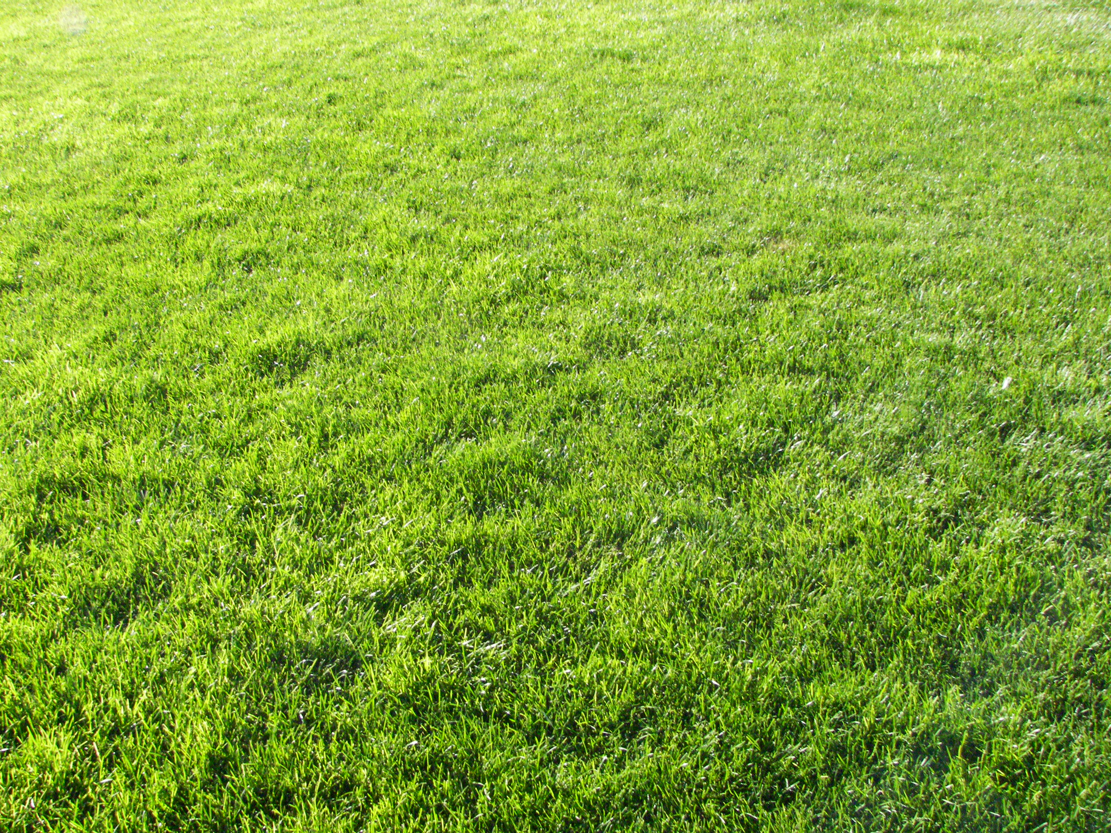
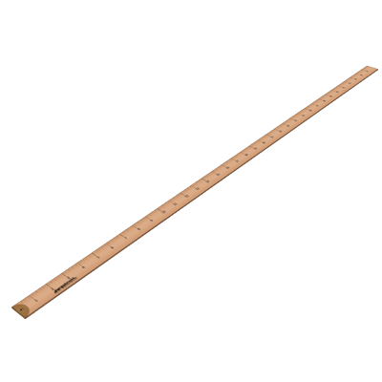
Ground Rules
RefreshCache v4

Slide 5
Brisk Paced
Respect everyone’s time
In the spirit of a good TED Talk…
Try to keep each session briskly paced
We understand that we ride the edge of burnout during these three+ days
We LOVE prepared demos…
Limit “struggling with demos”

Slide 6
Share, Learn, Inspire, Collaborate
You’re here to share something
Learn something
Inspire others & be inspired
Help someone
Collaborate

Slide 7
Quid Pro Quo
You’ll get more out of RC if you can focus (pay attention)
Focus == input/output
Understanding that people have differing interests and some may have to work…
RefreshCache is what you make it
Notes:
Basically, the more you focus in on the sessions the more you’ll get out of them.

Slide 8
No Selling
No selling products
But…
You can “sell” your ideas; provided it’s to:
inspire
pitch your vision
or assembling a collaborative team

Slide 9
Demo Sign-Up
Demo Board is in the back of the room
During a break, sign up to present
We’ll just go through the demos according to the list

Slide 10
Go
C:\Projects\RC2012> cls

Slide 11
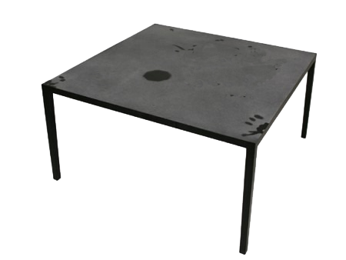
Ring for Service
Never mind...
we’re a Do-ocracy.

Slide 12
Some Definitions
“an organizational structure in which individuals choose roles and tasks for themselves and execute them. Responsibilities attach to people who do the work, rather than elected or selected officials.”
“The more you do in the project, the more solid your vote is.”
Favorite definition:
“if you see something that needs doing, DO IT.”

Slide 13
About
Our Do-ocracy
* Don't ask for it, go build it.
* Don't tell me, show me.
* If it's worth making, package and share it.
* Don't settle for what you already know; never stop learning.

Slide 14
Not the Burning Man Project
There may be some similarities…
"Burning Man is devoted to acts of gift giving. The value of a gift is unconditional. Gifting does not contemplate a return or an exchange for something of equal value."
Notes:
In doing my prep for this session I discovered something called “the Burning Man” or Burning Man Project. Although there are some clear similarities, we are in no way affiliate or want to be associated with this group.

Slide 15
Devoted to God
Matthew 22:37-39
³⁷Jesus replied: “‘Love the Lord your God with all your heart and with all your soul and with all your mind.’³⁸ This is the first and greatest commandment. ³⁹ And the second is like it: ‘Love your neighbor as yourself.’
Proverbs 11:25
The generous will prosper; those who refresh others will themselves be refreshed.

Slide 16
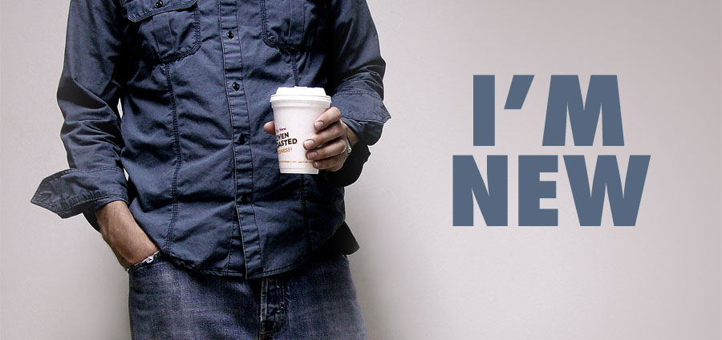
New to RC?
A few things you might not know

Slide 17
The Best Stuff
Some of best stuff has come from the community
Vendors can only do so much – and they don’t have the perspective that you (we) have
Here are some of the things the you (we) created or established…

Slide 18
IRC Channels
We hang out here:
#ArenaChMS (general arena discussions)
#ArenaChMS-DataAdmin (db admins)
#RockChMS (developer discussions, change & build notification)
?
Notes:
Brian Slezak

Slide 19
<sample server />
http://arena.refreshcache.com
Set up your modules there
Play with other’s modules
Use Daniel’s Sandbox

Slide 20
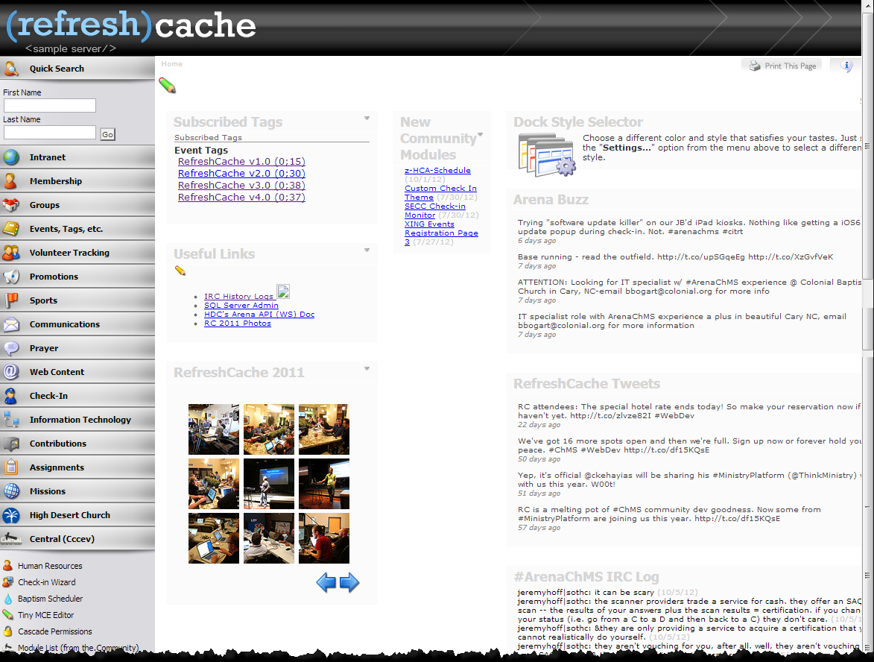
http://arena.refreshcache.com

Slide 21
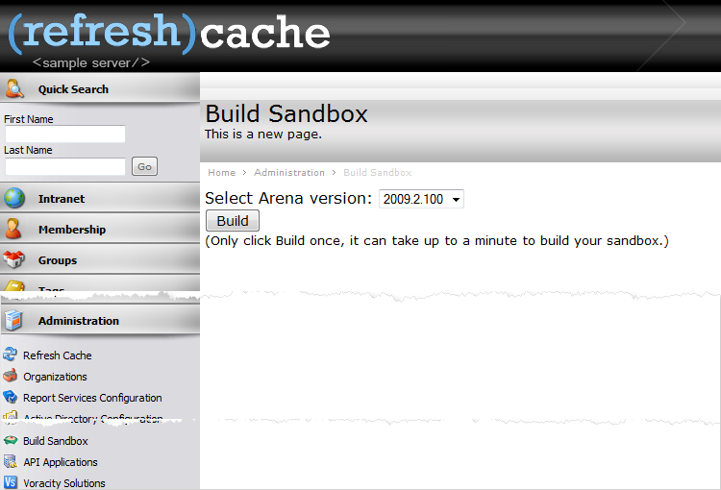

Slide 22
Project Server
http://redmine.refreshcache.com
or…
http://github.com

Slide 23
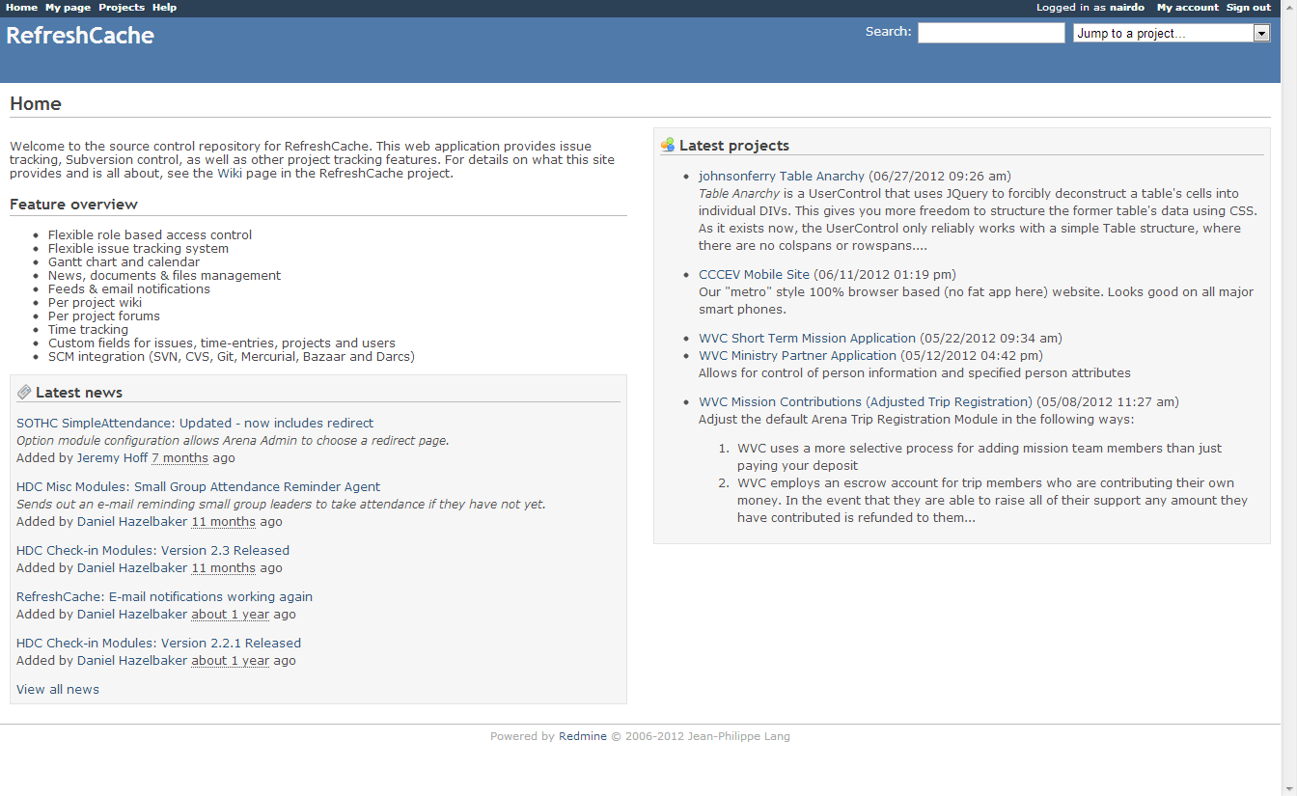

Slide 24
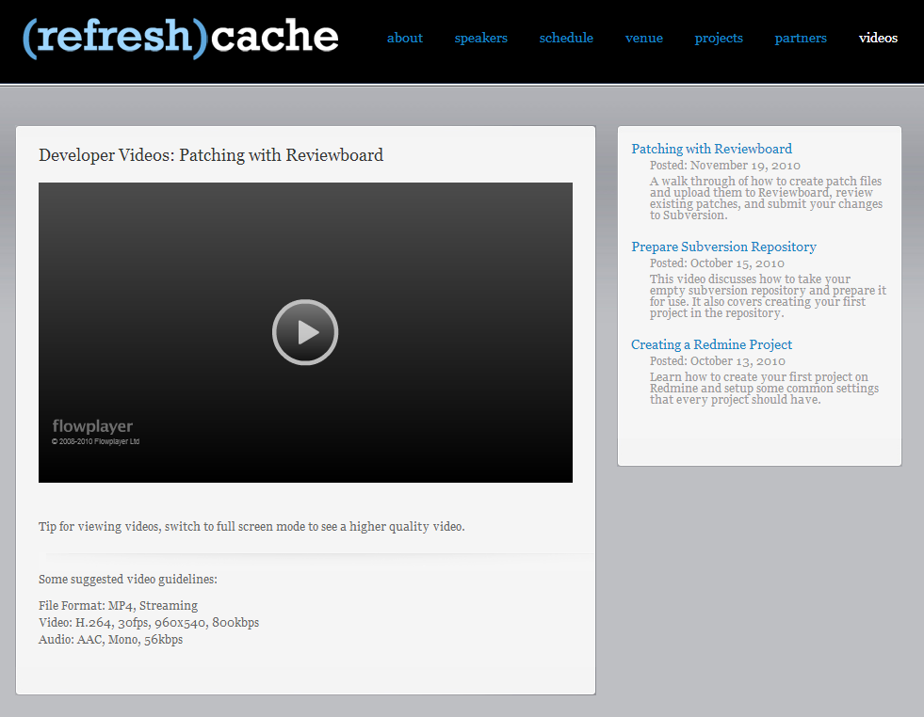
Daniel’s Videos

Slide 25
Past Presentations
http://refreshcache.github.com/presentations/

Slide 26
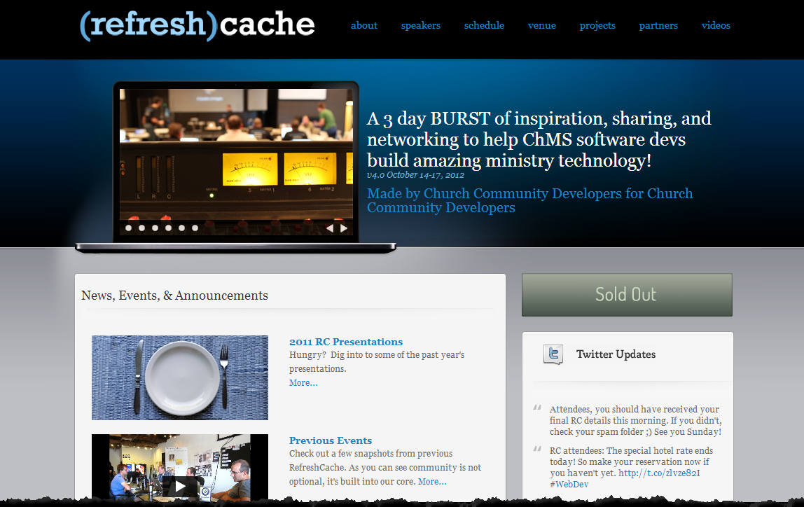
this.Conference ;)

Slide 27
And a shared toolset…

Slide 28
an open source ChMS

Slide 29
call to action
Last year’s

Slide 30
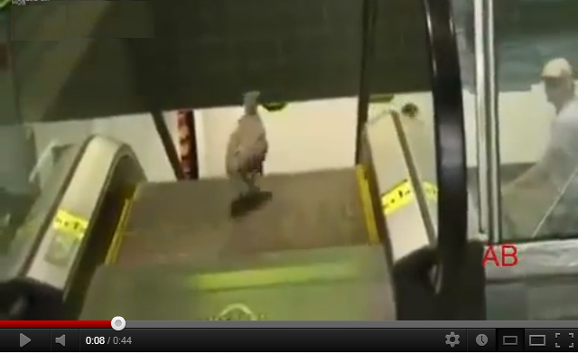
Remember This?
Notes:
Git, Github Wiki’s, Github pages, Jenkins,

Slide 31
…And This?

Slide 32
And Jon’s Call to Action/Change?
‘Have you taken something to the next level?’
‘Did anyone add a block of time on their schedule to think/create/innovate?’
“How are you better this year?”
“What hobbies did you pick up in the last year?”
“What have you learned this year?”
“What new thing will you learn next year?”
Notes:
Git, Github Wiki’s, Github pages, Jenkins, gardening

Slide 33
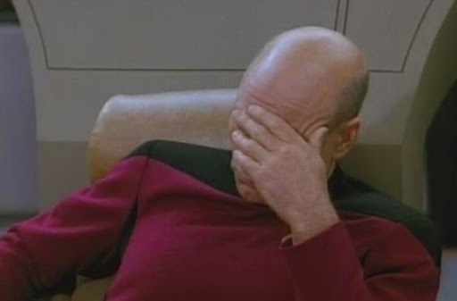
Don’t Worry

Slide 34
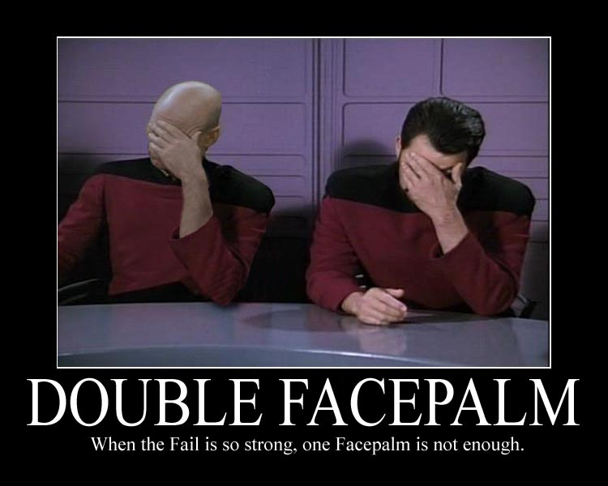
Notes:
No, seriously, don’t worry. Just try.

Slide 36
But seriously, this is a new year!

Slide 37
Worth repeating
Let’s end with something that’s

Slide 38
‘You were created in the image of God! What are you waiting for?!!! The moment you met Jesus something came alive in you. The Church needs to reclaim the epicenter of creativity for the human race. We used to be the best poets, scientists.’
- Erwin McManus

Slide 39
references
http://prokoudine.info/blog/2010/07/doacracy/
http://en.wikipedia.org/wiki/Burning_Man
http://vimeo.com/30387325 (Going to the Next Level)

