Slide 1
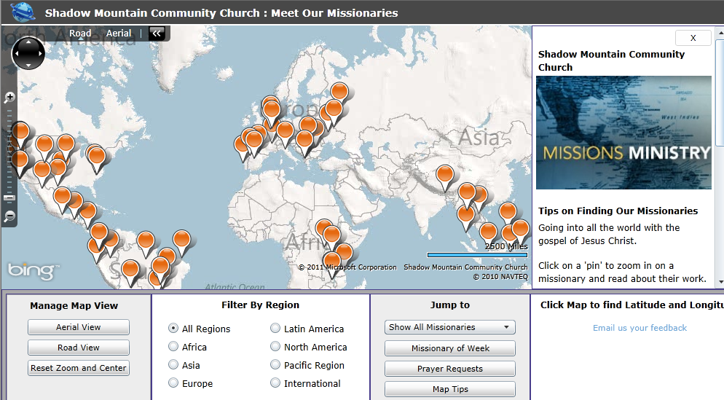
Plotting the Spread of the Gospel with Silverlight Maps
Michael Speers
Director of Web Services
Shadow Mountain Ministries
mspeers@shadowmountain.org
http://maps.shadowmountain.org

Slide 2
What is Silverlight?
Browser plug-in for building RIA's.
Looks to enhance the user interface beyond where HTML can go.
Scalable vector graphics and animation.
HD Video
Michael Speers
Director of Web Services
Shadow Mountain Ministries
mspeers@shadowmountain.org

Slide 3
What is Silverlight?
Xaml
Code behind
Xap
Other resources
Michael Speers
Director of Web Services
Shadow Mountain Ministries
mspeers@shadowmountain.org

Slide 4
Why use Silverlight?
Our use case
Since it runs in a browser…
One App has replaced approximately 100 individual Missionary pages in Arena.
Increase the usefulness of data by showcasing it in a way that might otherwise be hard to see.
Developer perspective: Brings .NET Framework for features running in the browser.
Cross platform* and cross-browser**
*, ** - Next slide for drawbacks
Michael Speers
Director of Web Services
Shadow Mountain Ministries
mspeers@shadowmountain.org

Slide 5
Drawbacks
No plugin for the iDevices or Android
No plugin for Linux from Microsoft (Open Source Solution for Silverlight on Linux - http://www.mono-project.com/Moonlight)
Michael Speers
Director of Web Services
Shadow Mountain Ministries
mspeers@shadowmountain.org

Slide 6
Getting Started
http://silverlight.net Silverlight SDK
http://bingmapsportal.com Map SDK Bing Maps Key
VS 2010 ships w/ Silverlight 3
Can Add Silverlight 4 Developer Tools
Michael Speers
Director of Web Services
Shadow Mountain Ministries
mspeers@shadowmountain.org

